Slide 1
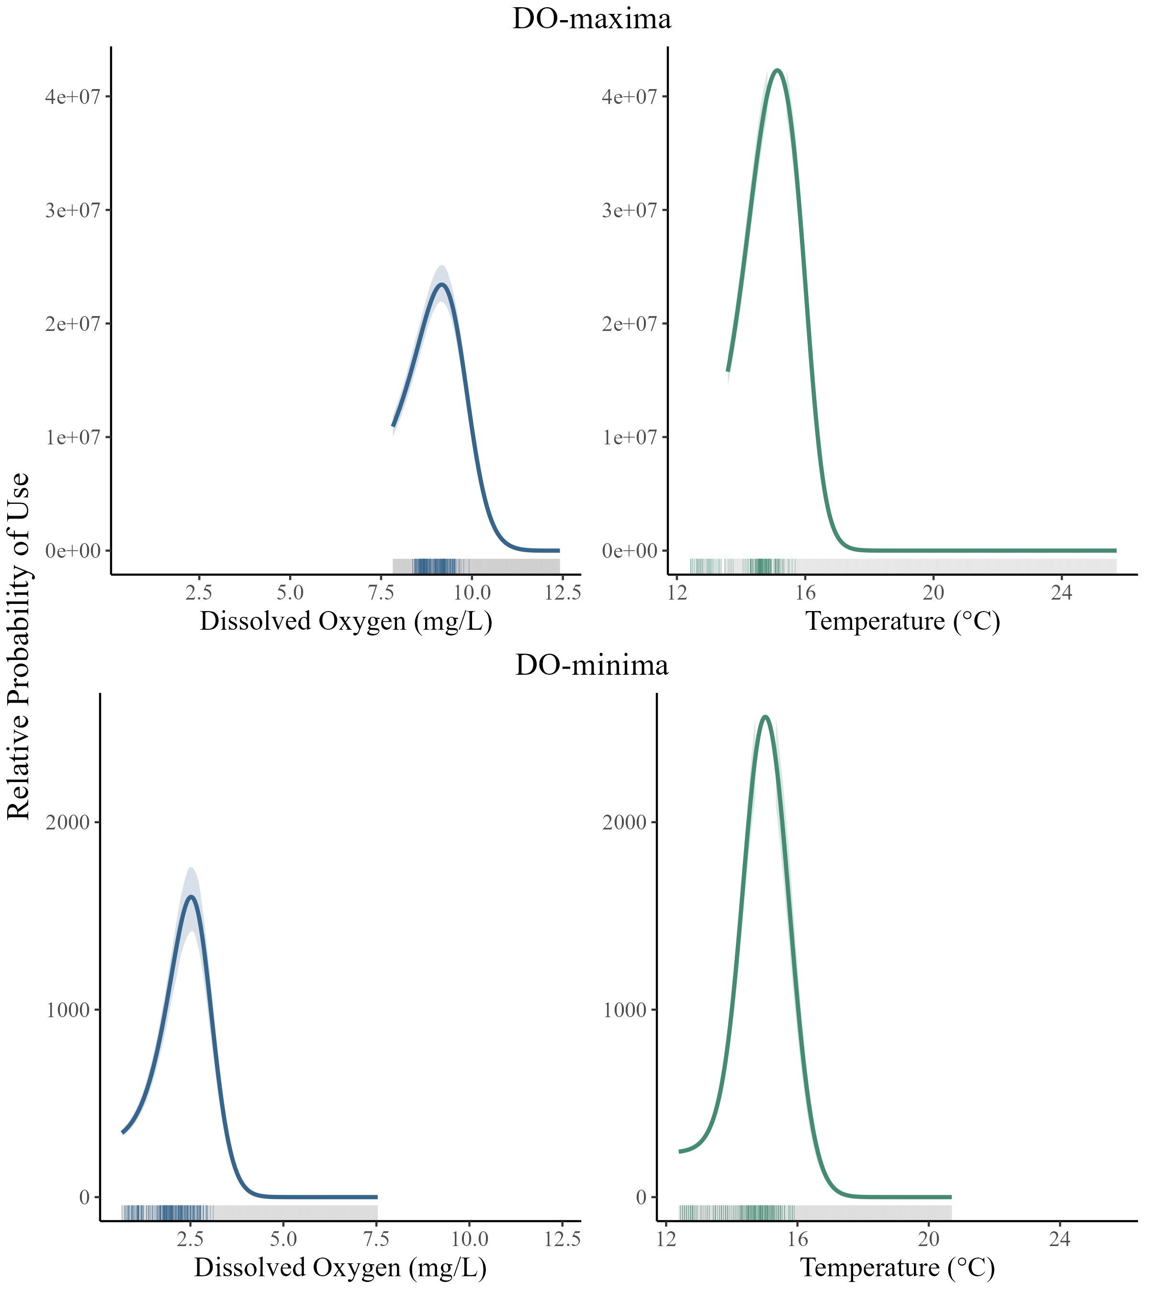
Variable | DO-maxima | DO-minima
Available range temperature (°C) | 12.25 – 25.71 | 11.81 – 20.70
Available range DO (mg L⁻¹) | 7.82 – 12.42 | 0.66 – 7.54
Peak selection probability temperature (°C) | 15.13 | 15.02
Peak selection probability DO (mg L⁻¹) | 9.17 | 2.52
Notes:
Norwood 08/01-04- don’t go for coldest water, probably because of DO, but will hit 2.5 to keep temps low

Slide 2
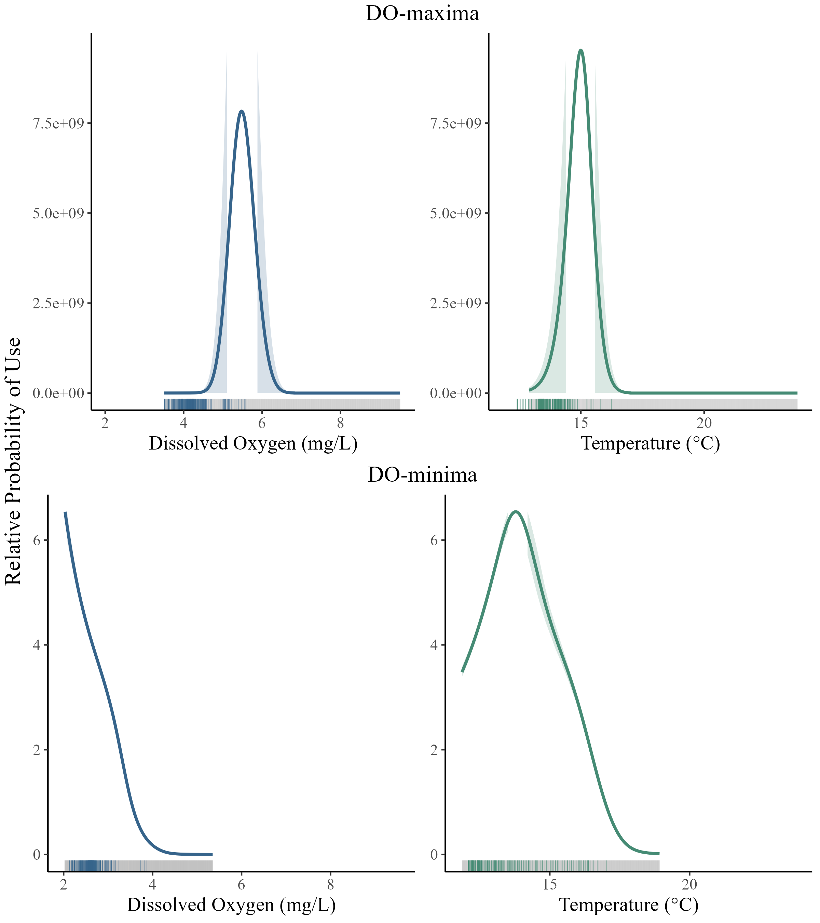
Variable | DO-maxima | DO-minima
Available range temperature (°C) | 12.38 - 23.79 | 11.69 - 18.94
Available range (mg L⁻¹) | 3.50 - 9.52 | 1.97 - 5.35
Peak selection probability temperature (°C) | 15 | 13.78
Peak selectionprobability DO (mg L⁻¹) | 5.48 | 2.02
Notes:
Blue Ruin 08/01-04 -

Slide 3
Norwood 08/01-08/04
Blue Ruin 08/01-08/04
Window | Model | AIC
DO-maxima (high) | *Temperature only | 337.1423
DO-maxima (high) | Temperature & DO | 339.0852
DO-maxima (high) | DO only | 810.0345
DO-minima (low) | *Temperature & DO | 658.3948
DO-minima (low) | Temperature only | 670.3939
DO-minima (low) | DO only | 736.8786
Window | Model | AIC
DO-maxima (high) | *Temperature & DO | 1064.542
DO-maxima (high) | Temperature only | 1202.181
DO-maxima (high) | DO only | 1457.523
DO-minima (low) | *Temperature & DO | 1716.744
DO-minima (low) | Temperature only | 1778.461
DO-minima (low) | DO only | 1837.514
Notes:
DO and Temp are both considered (improved AIC) except for Norwood during DO maxima where Temperature has best AIC (both is only slightly worse). For all models, Temperature only model is almost as good as model with both Temp and DO, so while both are important (except for Norwood during DO-maxima), temperature is the primary driver of movement. In Blue Ruin, having both Temp and DO in model does meaningfully improve AIC score for both DO-minima and DO-maxima….

Slide 4
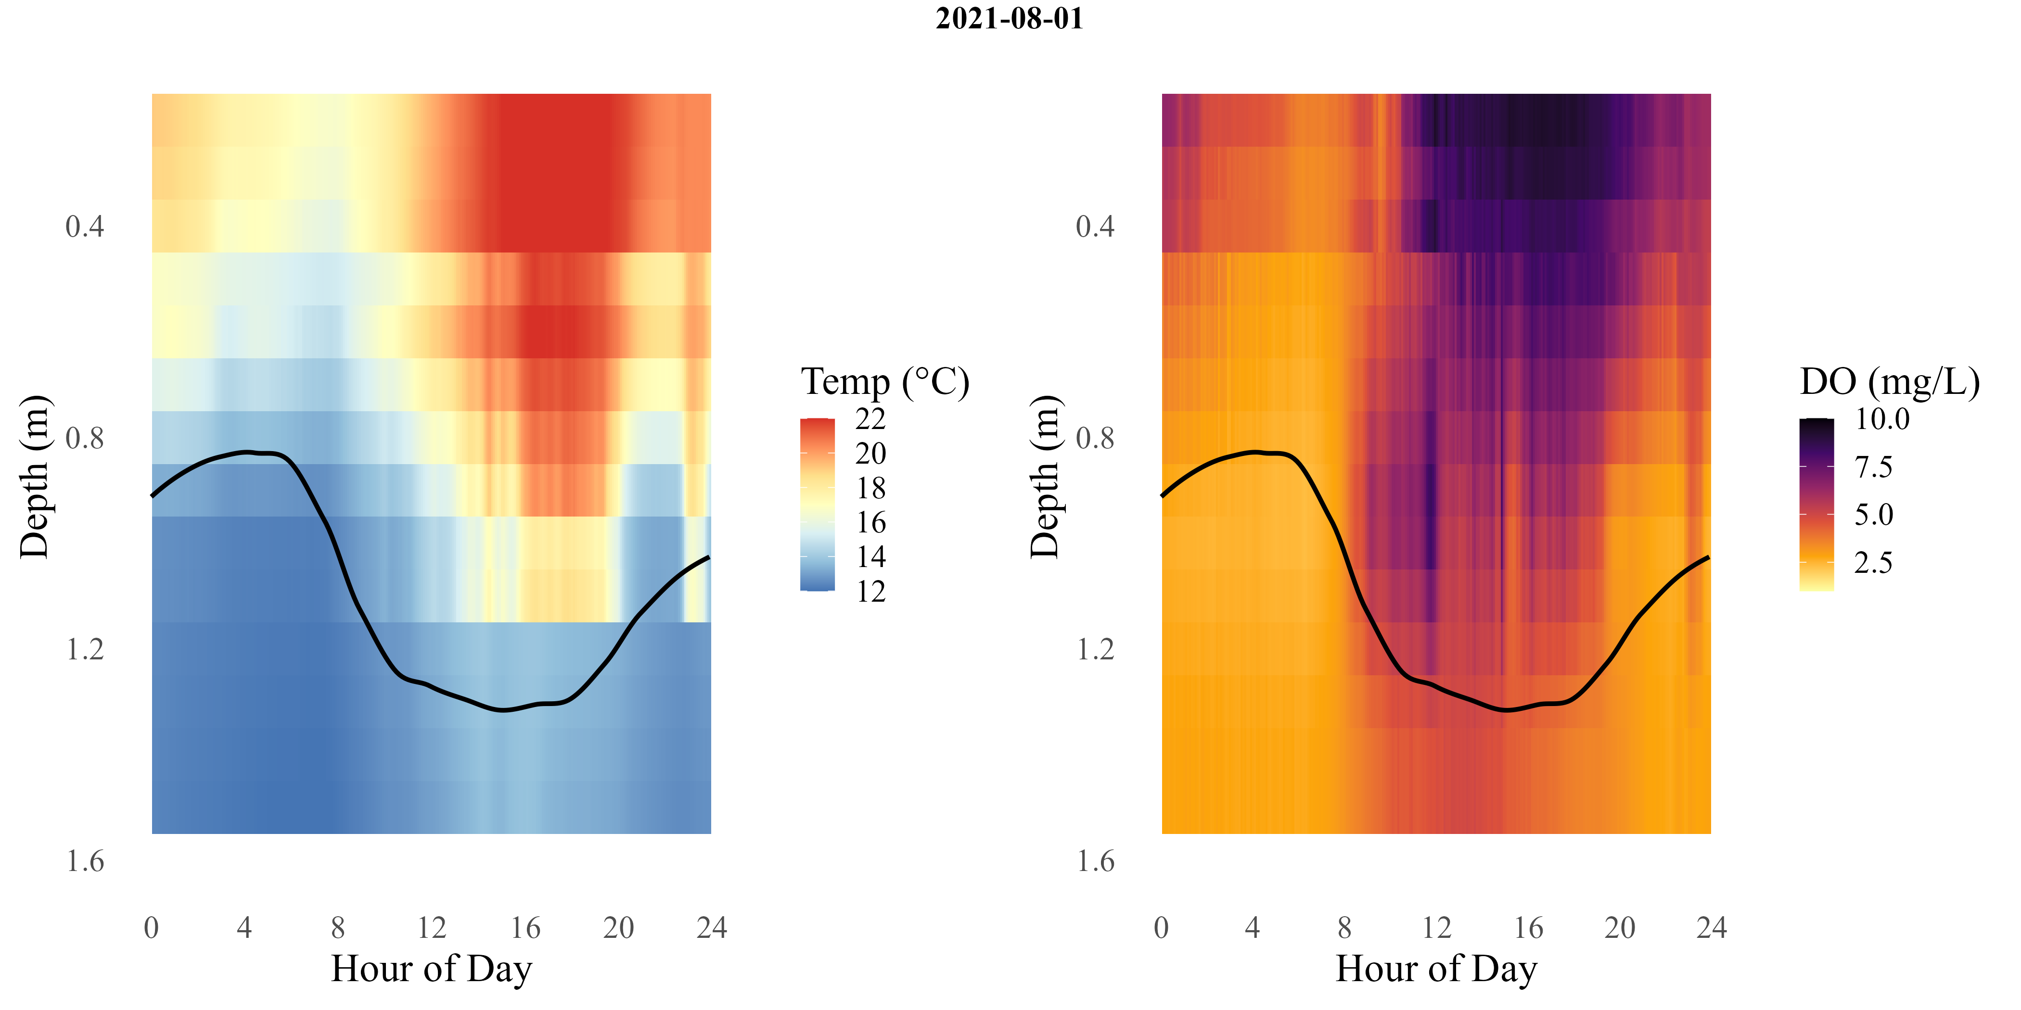
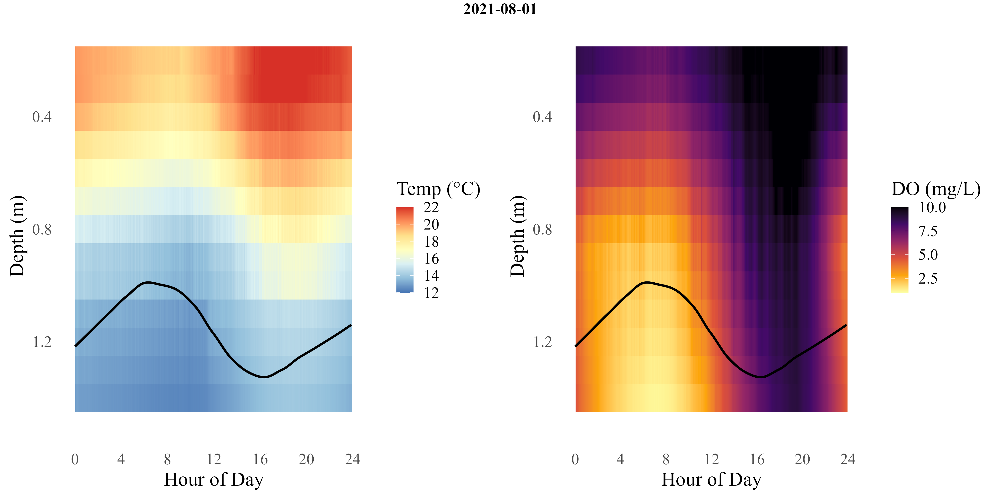
a
b
c
d
Notes:
Blue ruin

Slide 5
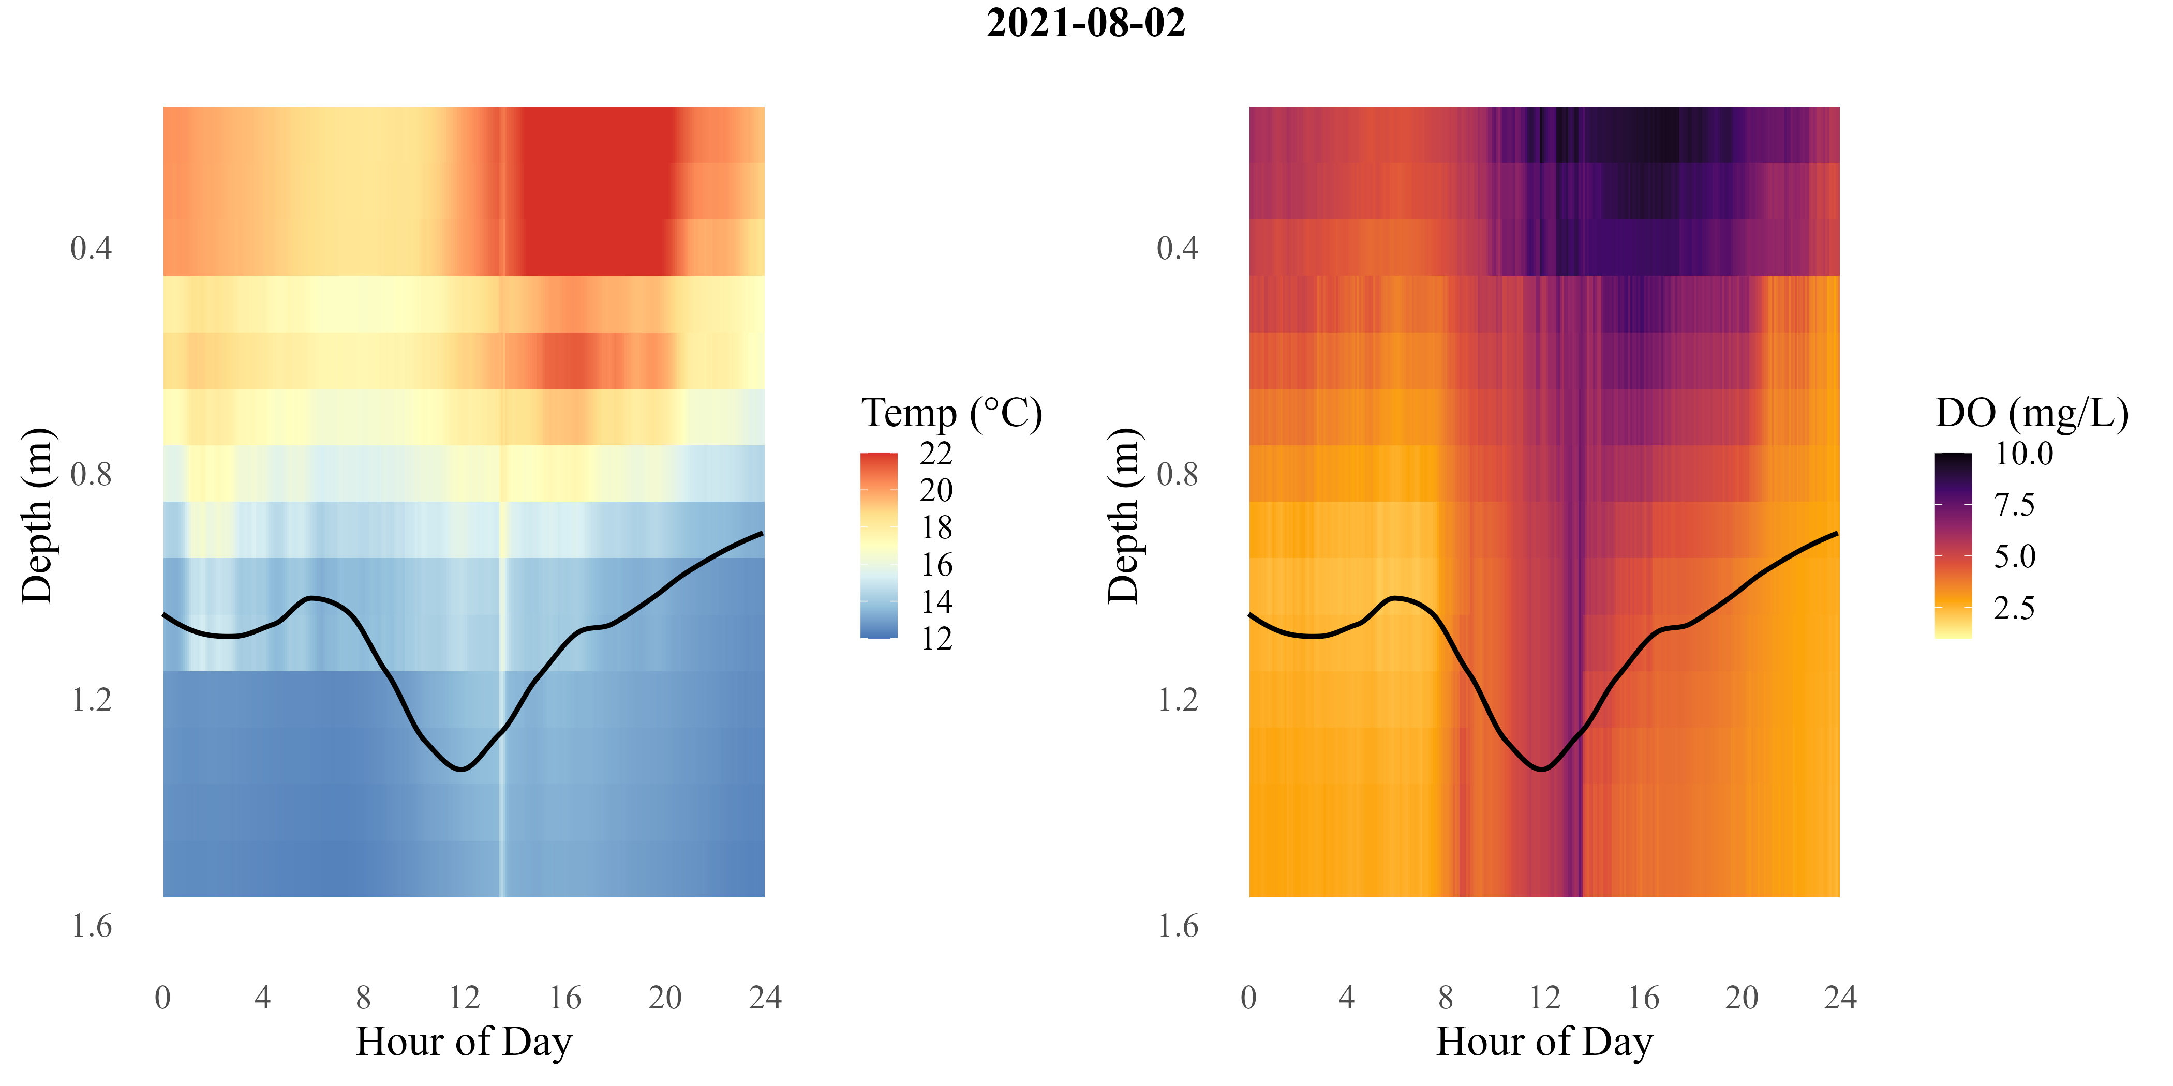
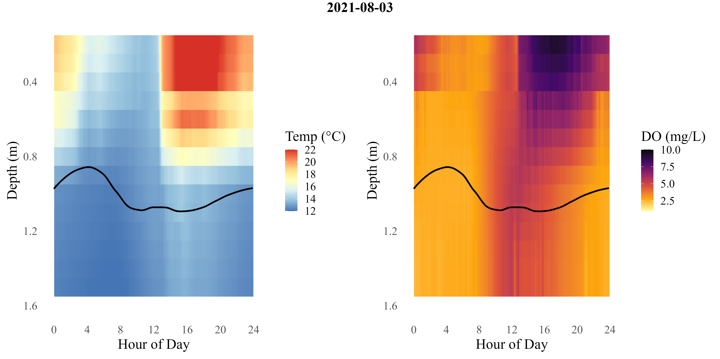
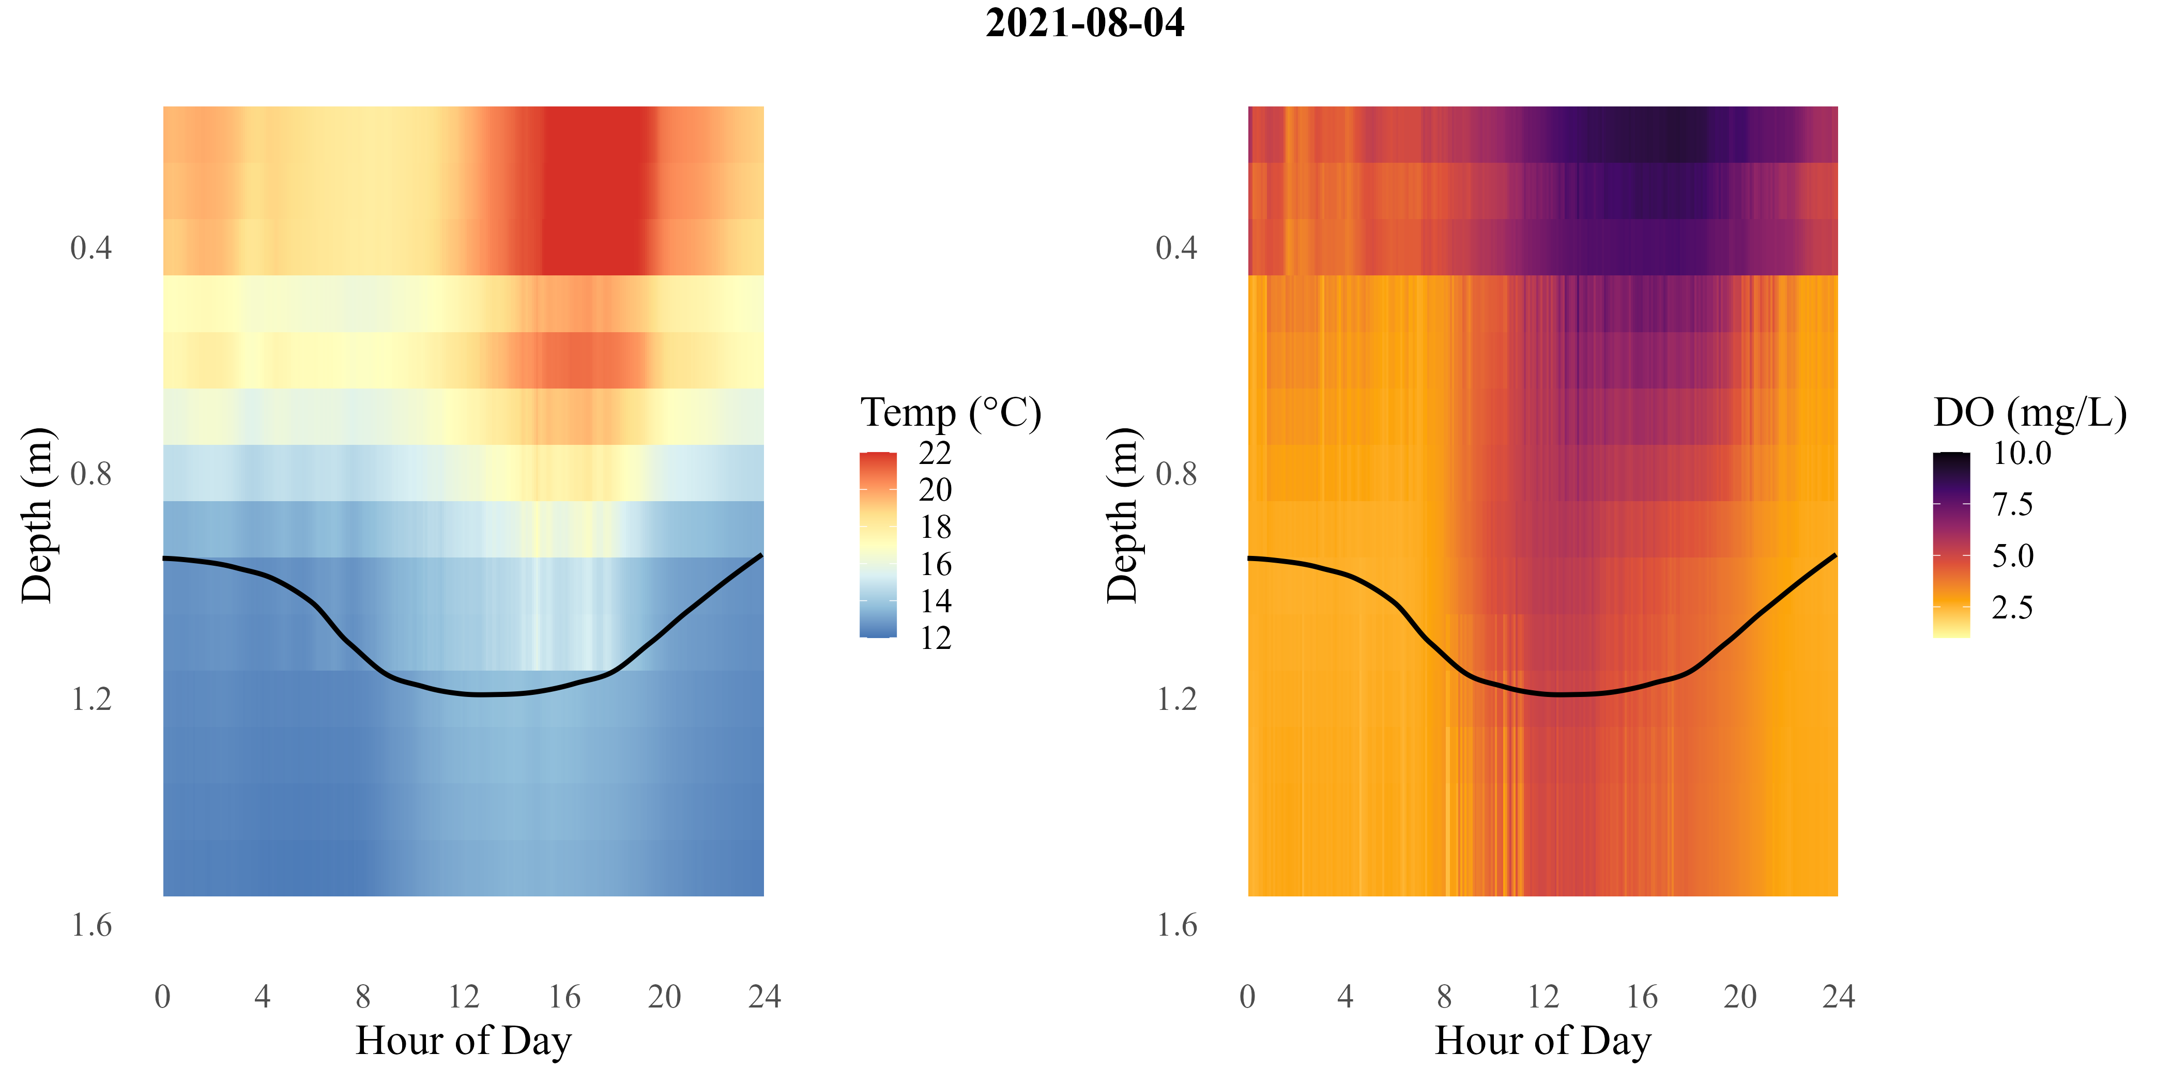
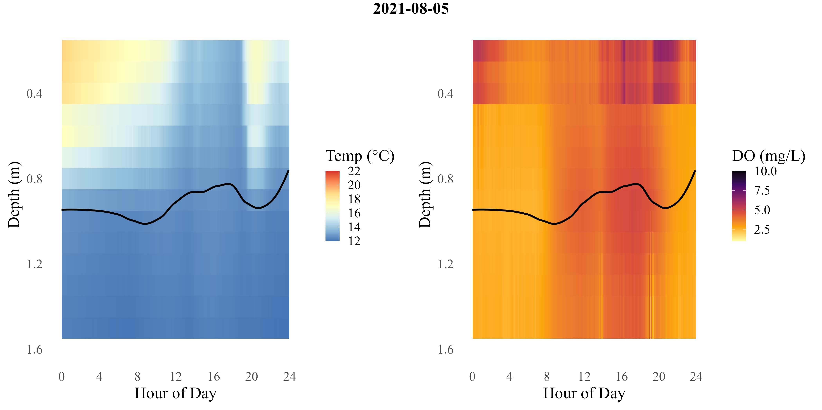
d
Notes:
Blue Ruin

Slide 6
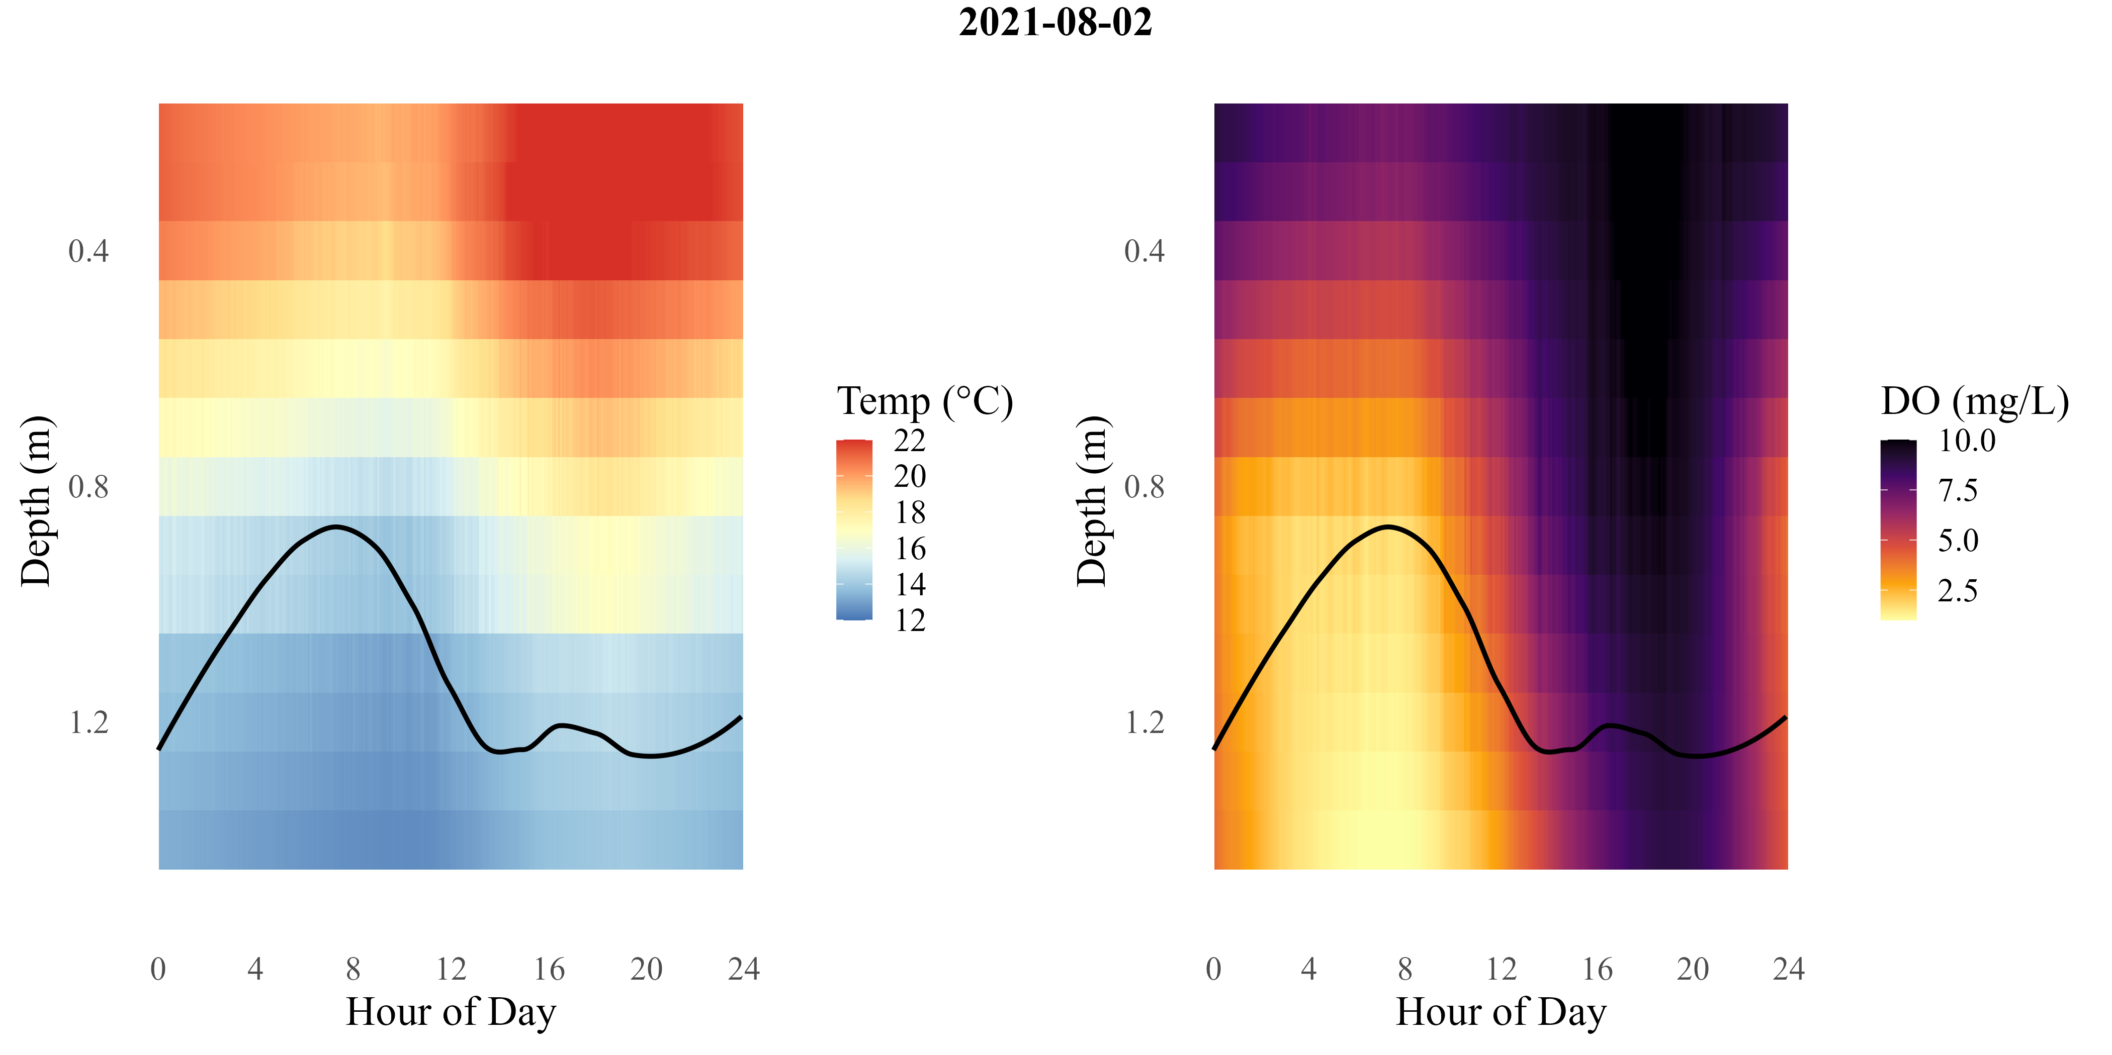
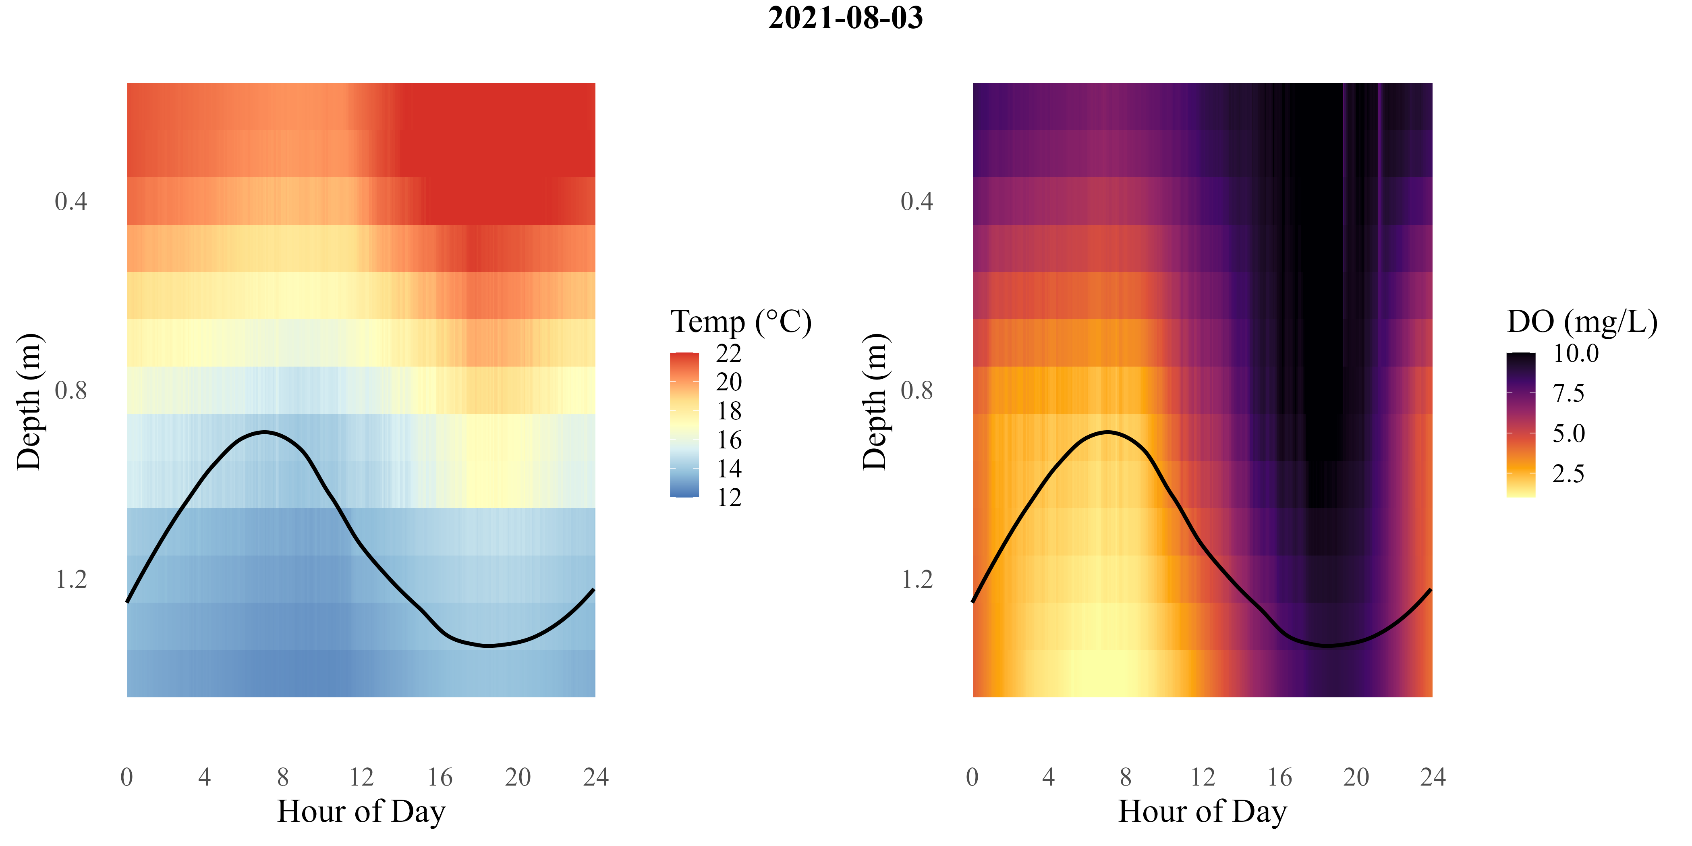
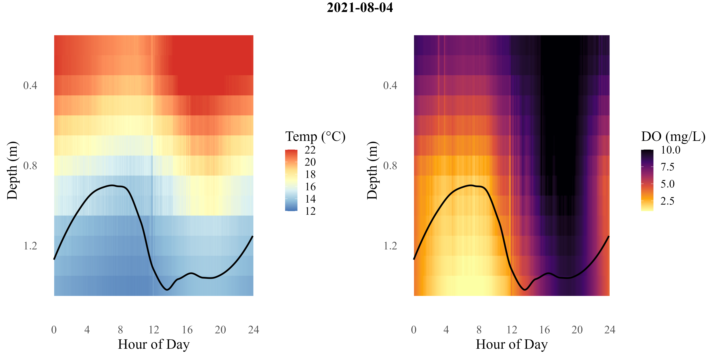
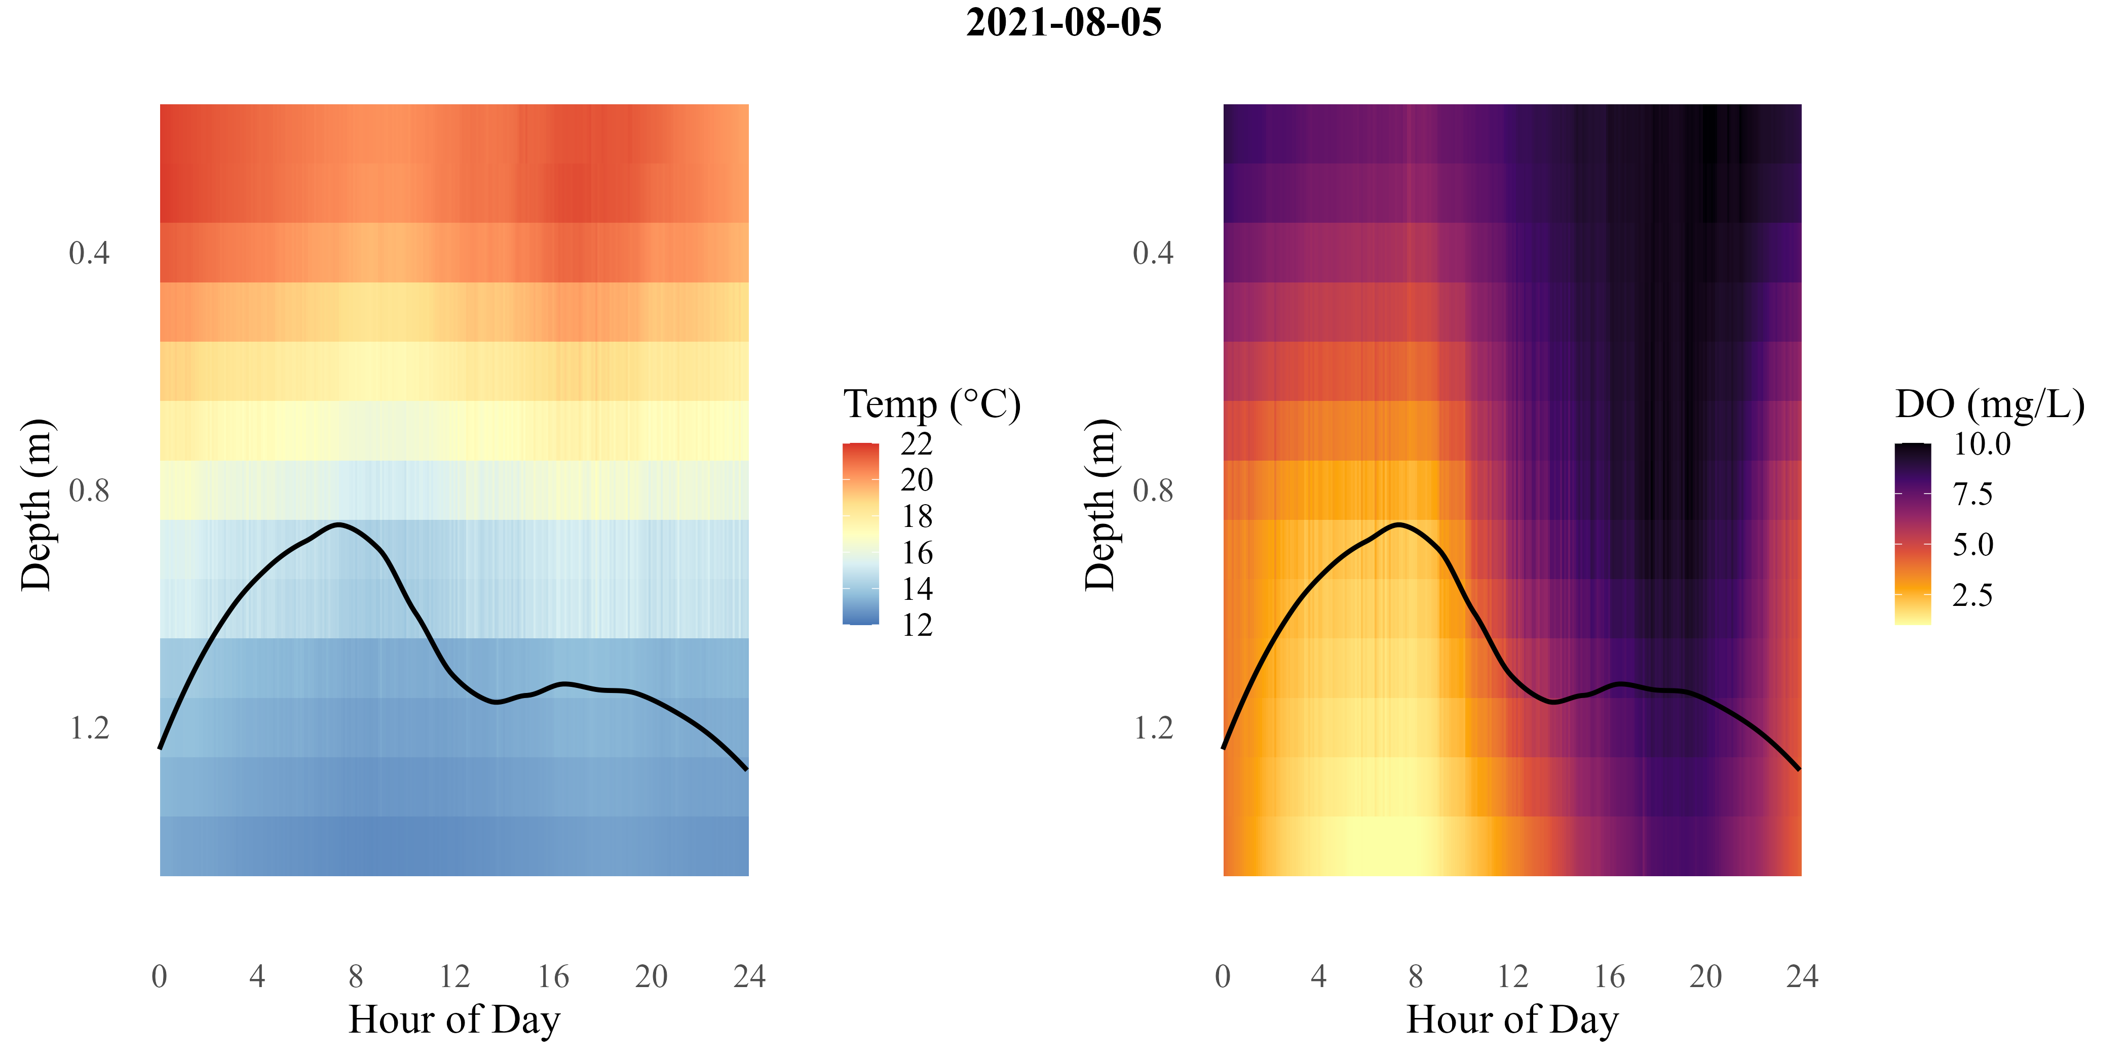
Notes:
Norwood

Slide 7
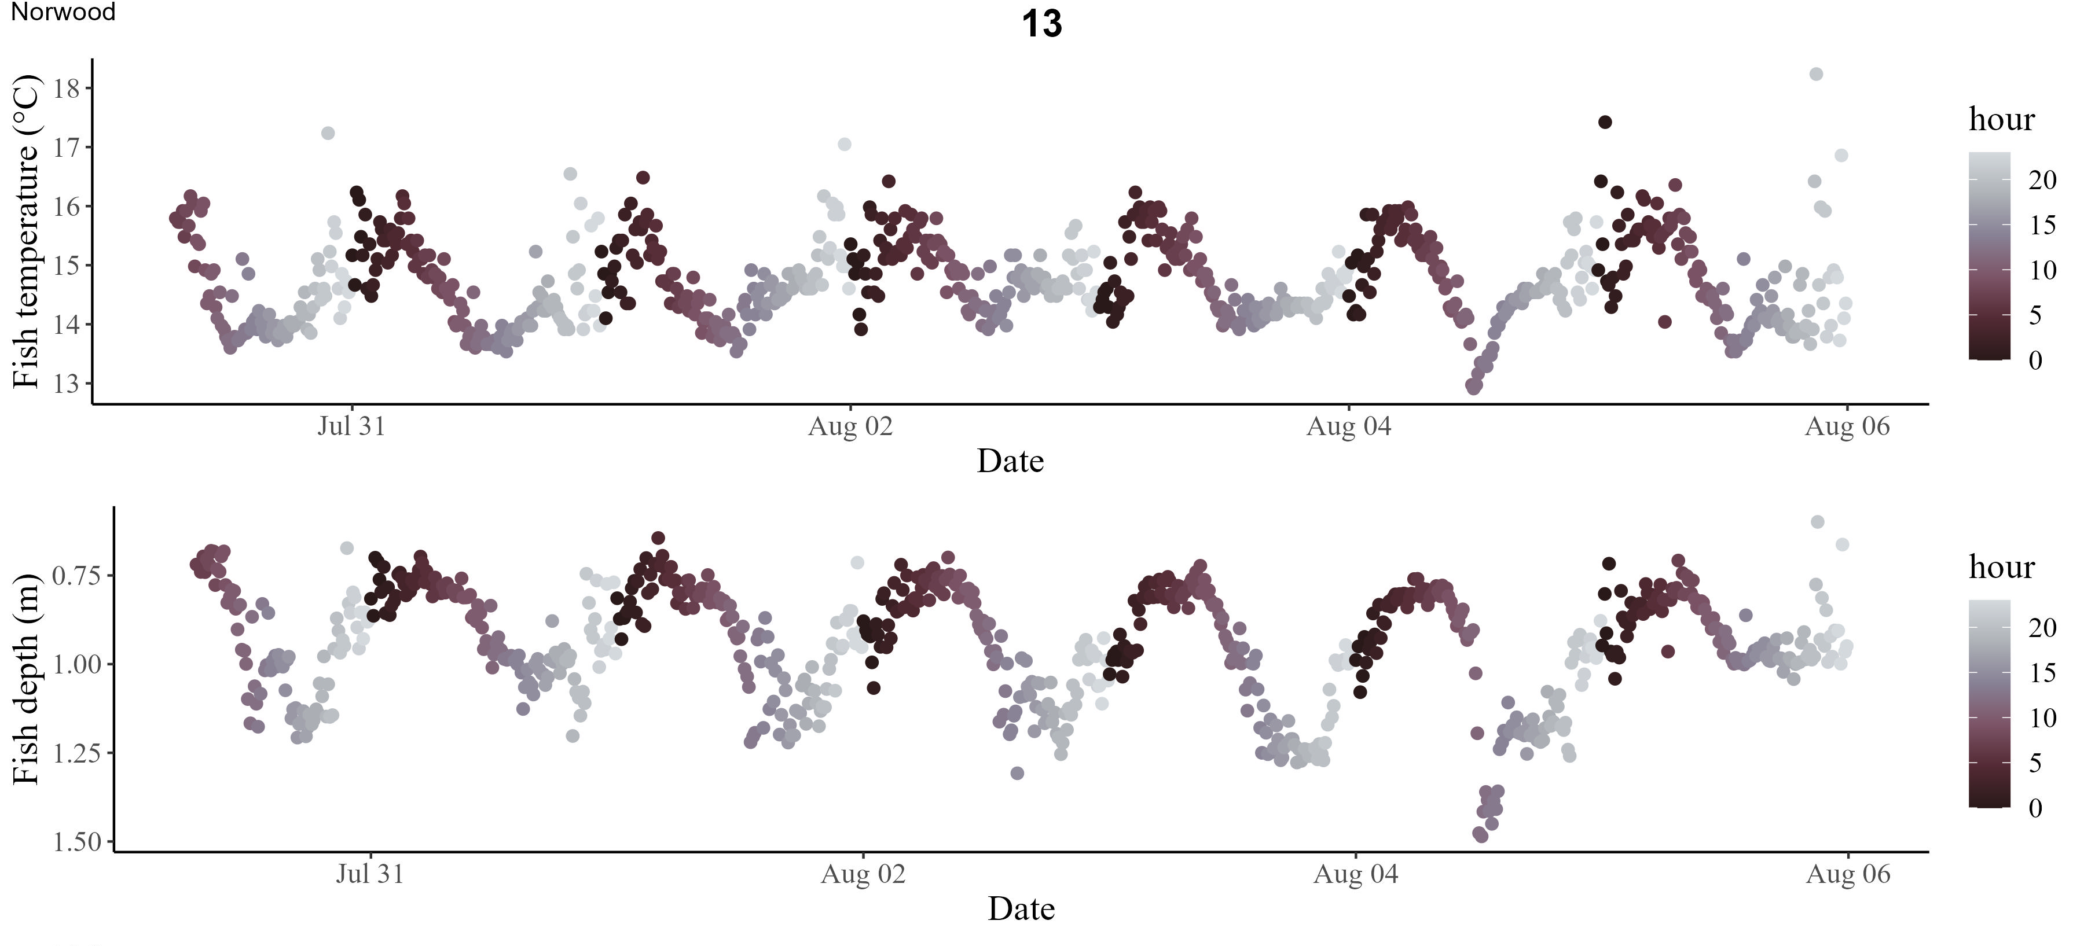
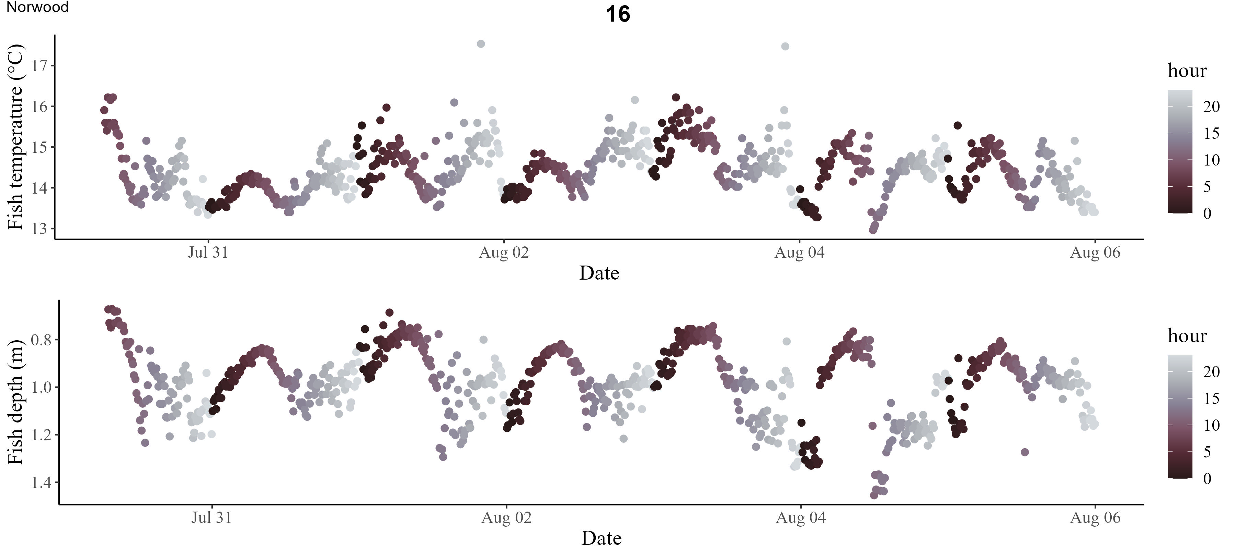
Notes:
Ok roughly the dark/mid-purple is DO-minima, light grey is DO-maxima.
Norwood – fish are doing what we’d expect and moving shallower in the water column during DO-minima and incurring warmer temperatures (trade-off)

Slide 8
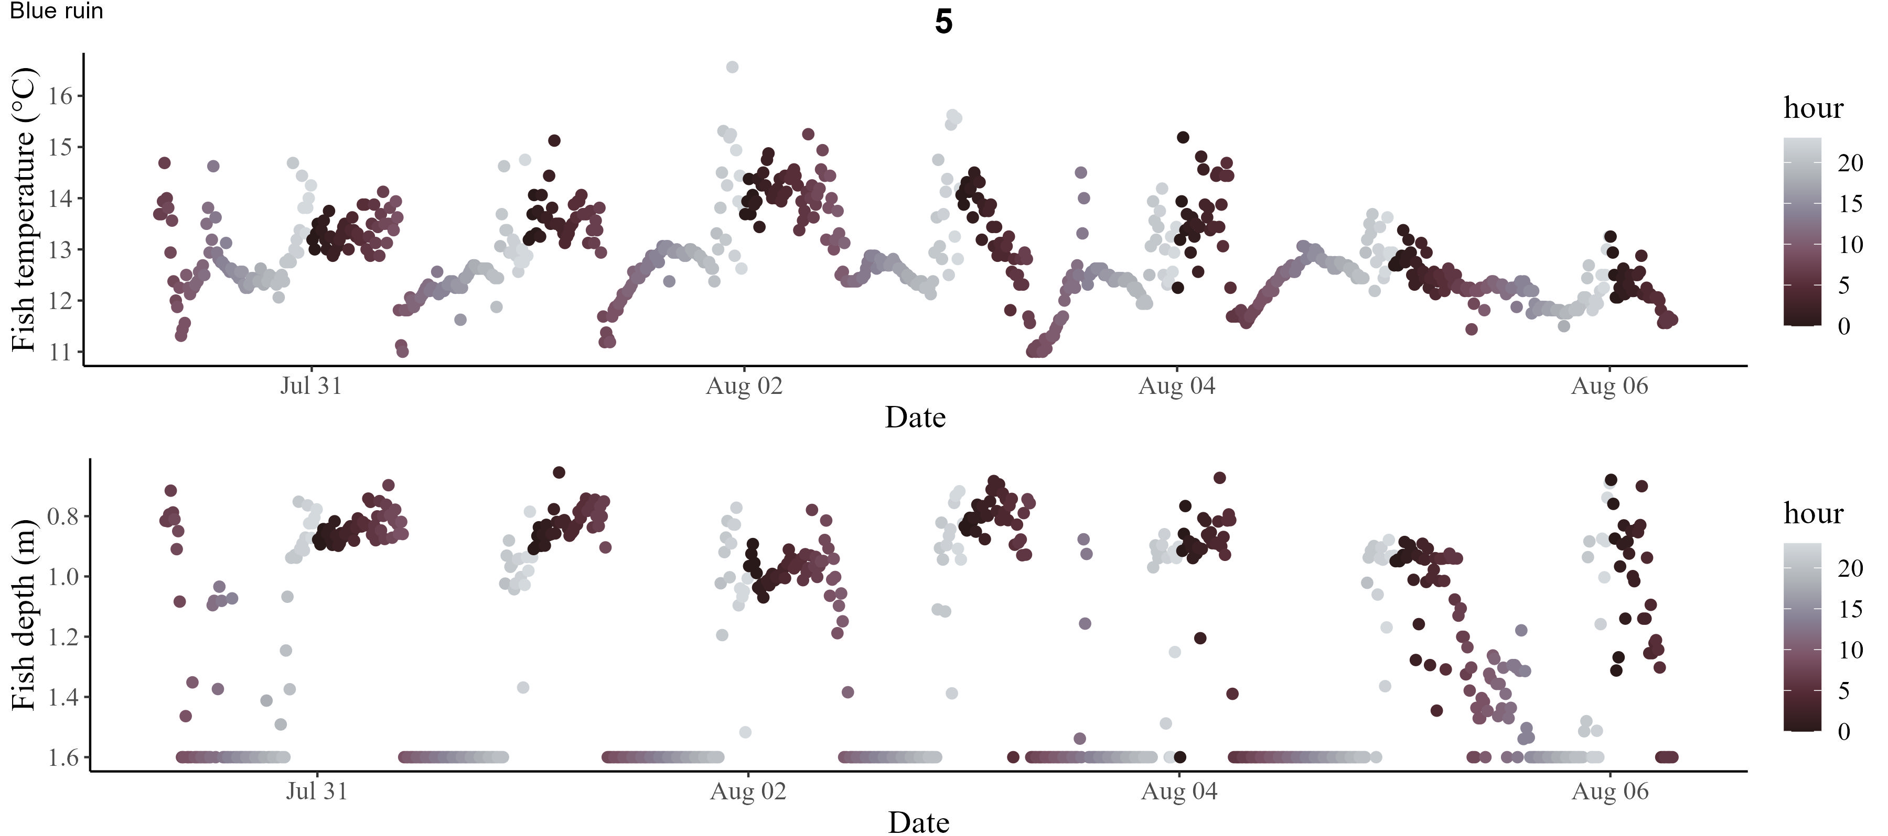
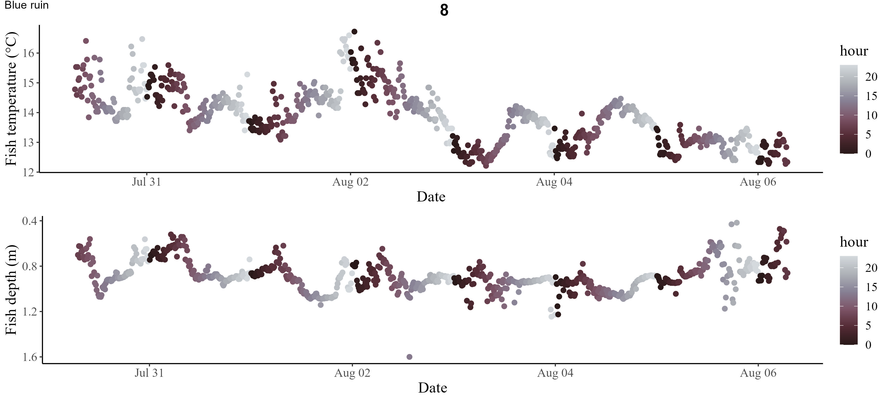
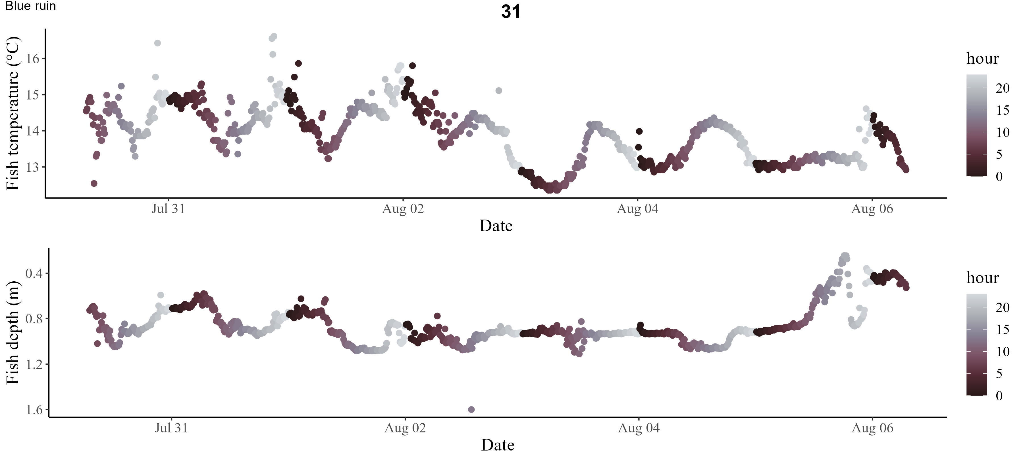
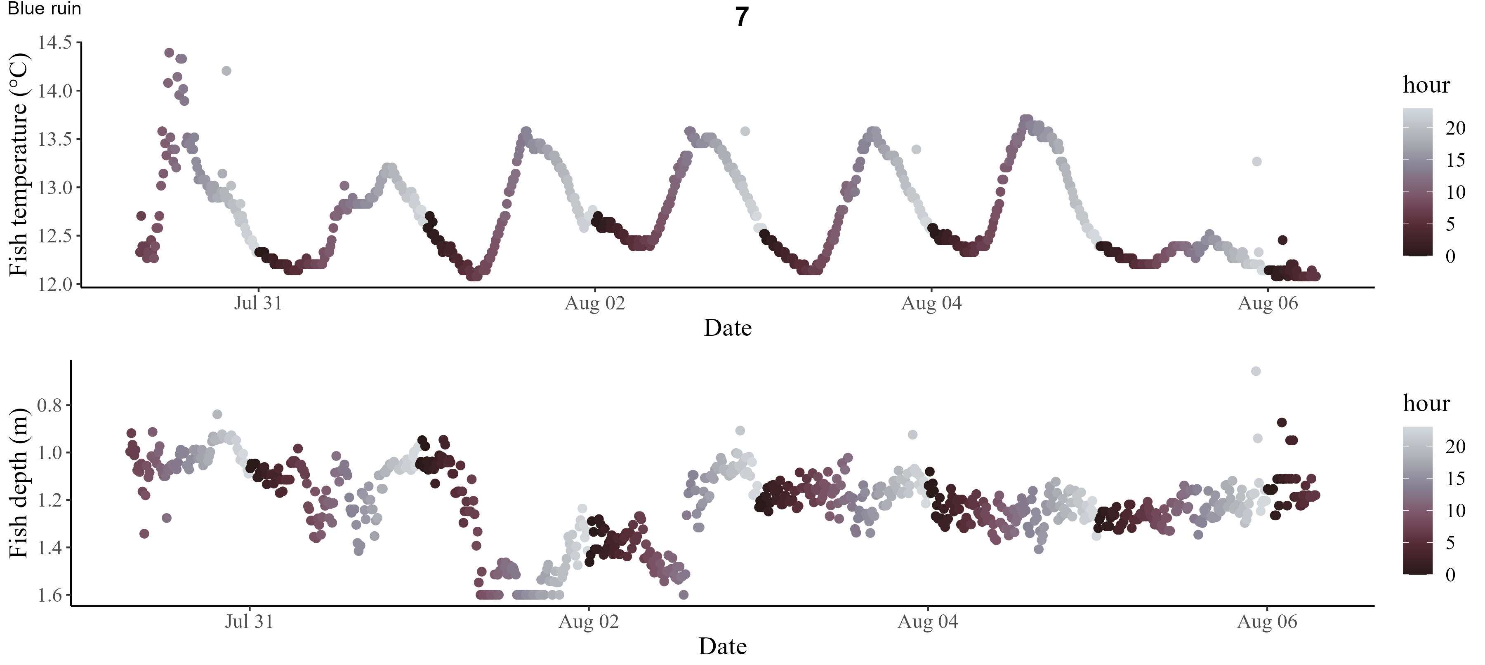
Notes:
Blue Ruin fish exhibit DVM with very inconsistent patterns among individuals and over time
Fish 5 shows expected moving shallower/warmer during DO-minima and deeper/cooler during DO-maxima
Fish 8 and Fish 31 initially follow similar pattern but then switch to cooler temperatures during DO-minima. Fish 8 still moves shallower but less distinctly, fish 31 DVM breaks down and switches to somewhat cooler temps during.
Fish 7 consistently showed an inverse pattern, moved to cooler temperatures during DO-minima and warmer temperatures during DO-maxima.
Individuals still move deepest during DO-maxima (daytime) but the temperature associated with depth shift varies widely. Variability likely contributes to counterintuitive model fit

Slide 9
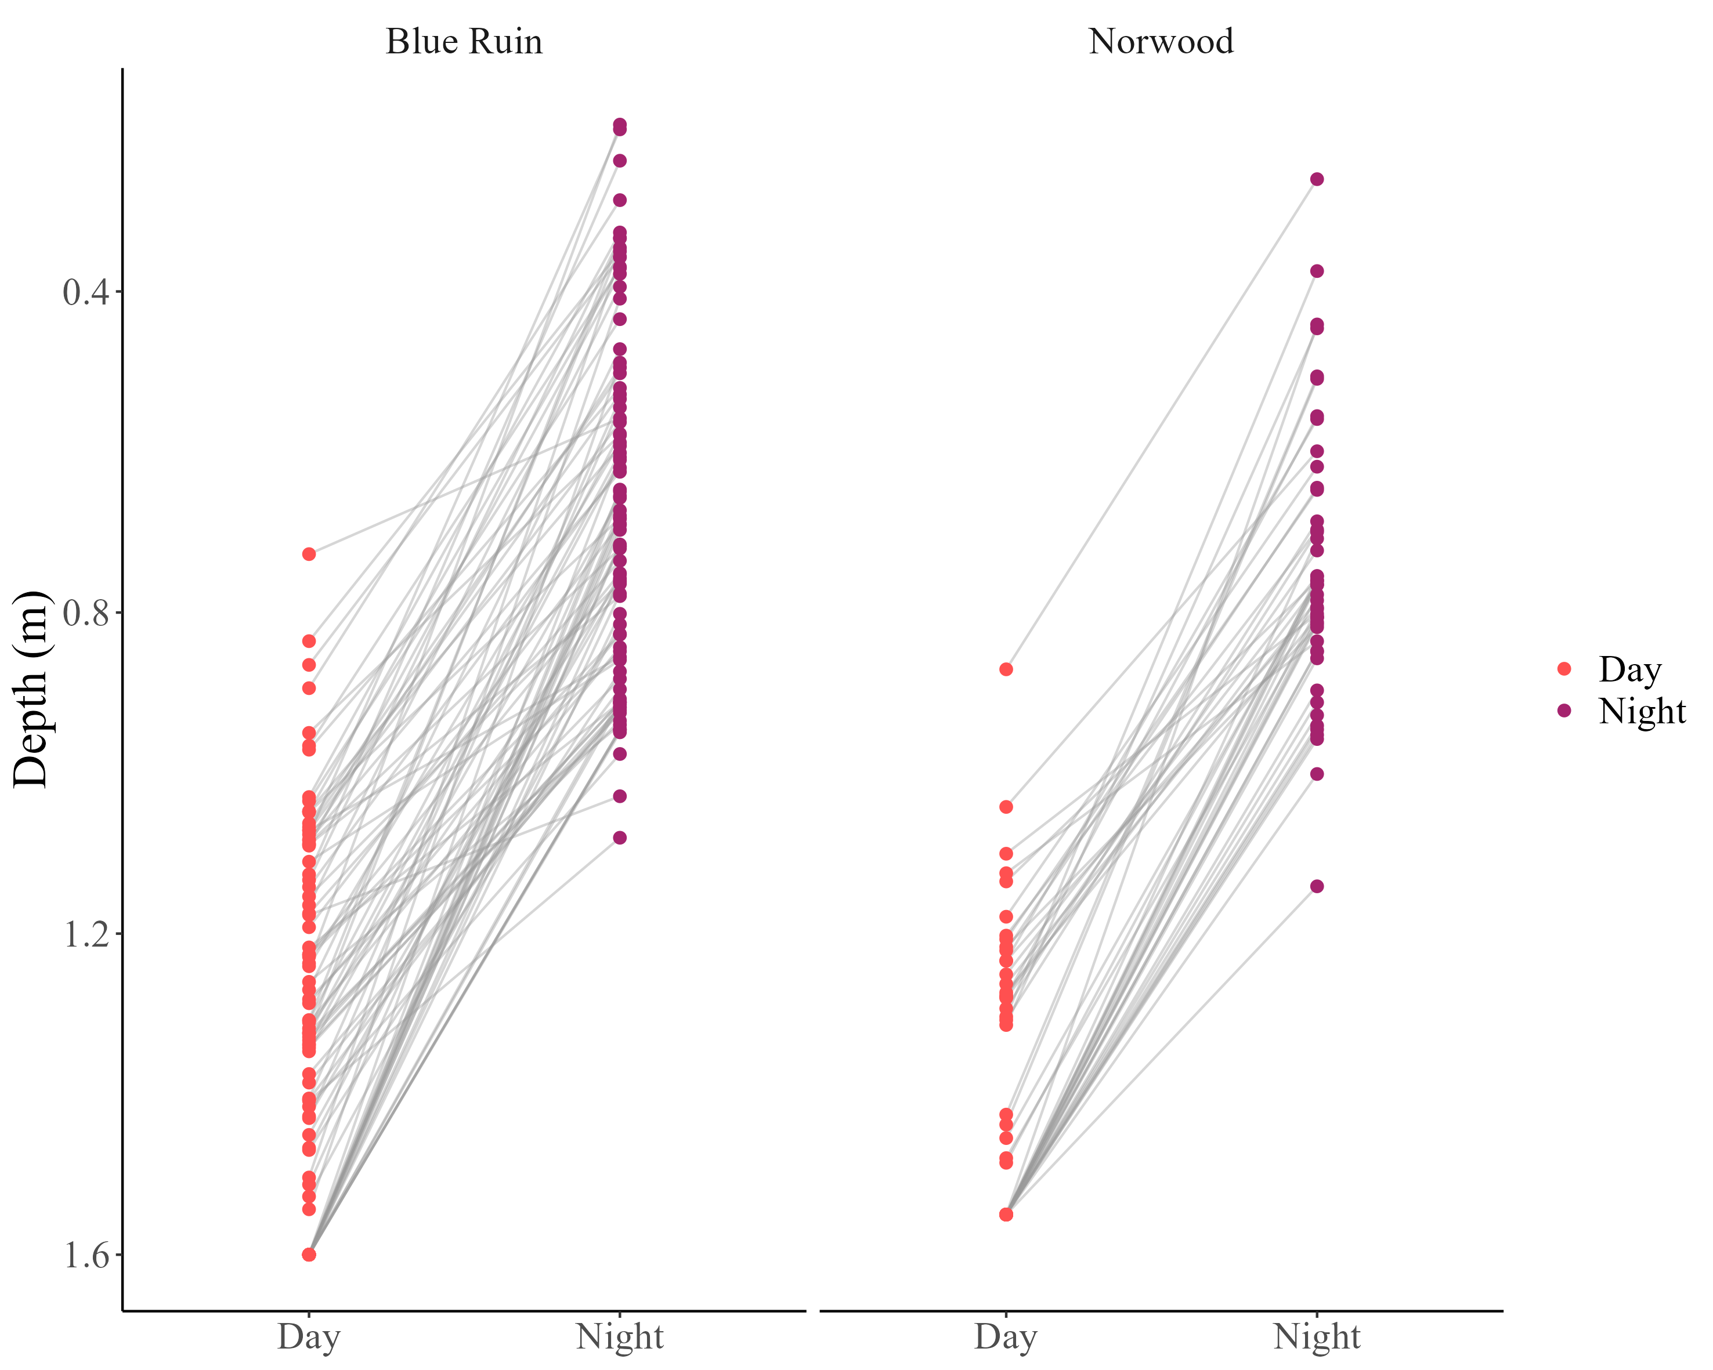
It seems like Norwood fish are tracking preferred temps whereas BR fish are showing a lagged response to changing conditions – for both however their absolute minimum and maximum depths are not perfectly aligned with the 2-hour windows we assigned as the DO-minima and DO-maxima. We can either leave the GAM analysis as is (see slide 1) and talk about how Norwood fish display more of what we anticipated, whereas Blue Ruin fish during DO-minima have varied responses in their temperature selection likely because DO is quite low throughout the water column (resulting in wacky selection probability and relatively low values on y-axis since they have such varied responses). Other option would be to determine what timestamp represented the absolute min/max depth for each fish for each day (remember point plot below), then average across fish/days per habitat to
come up with the ‘average’ time where they were at their min/max
depths, then re-run the analysis looking at that window
(keep 2-hr window or reduce window to 1-hour or something) – NOTE
I redid the analysis doing the above and it didn’t improve anything,
I think we should move forward with models shown on slide 1 & 2,
Also have individual models per day we can check out.
Notes:
Other to do – heat map is single day, DVM movement overlay is for a multi-day period. Taal wants separate plots per day, keep one as main figure and move rest into supplement.

